Slide 1
Instacart market basket analysis
Nikhila Valivarthi

Slide 2
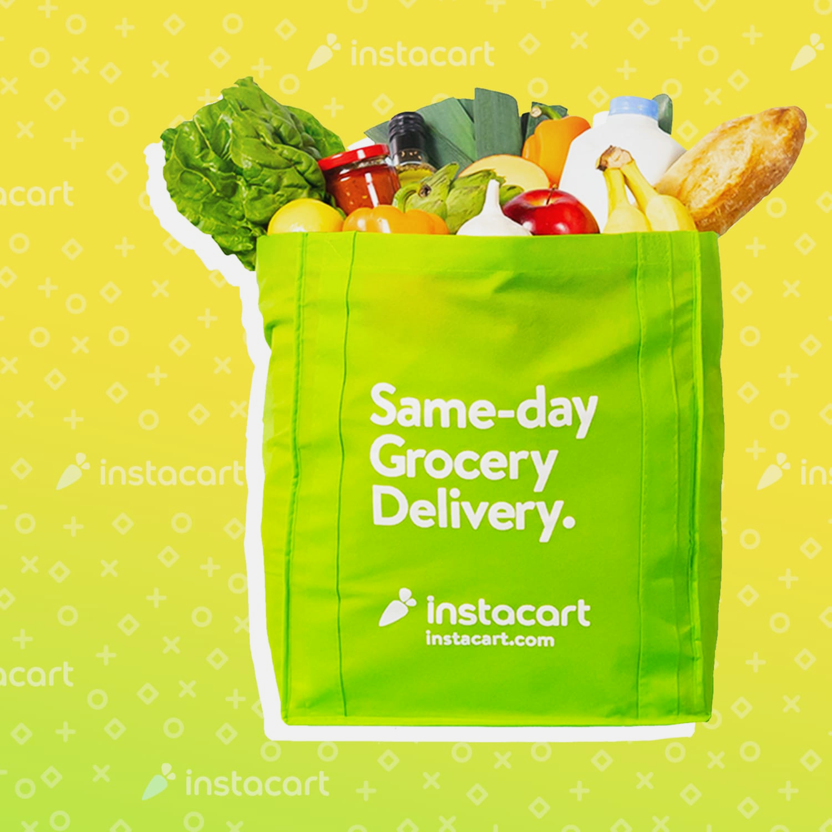
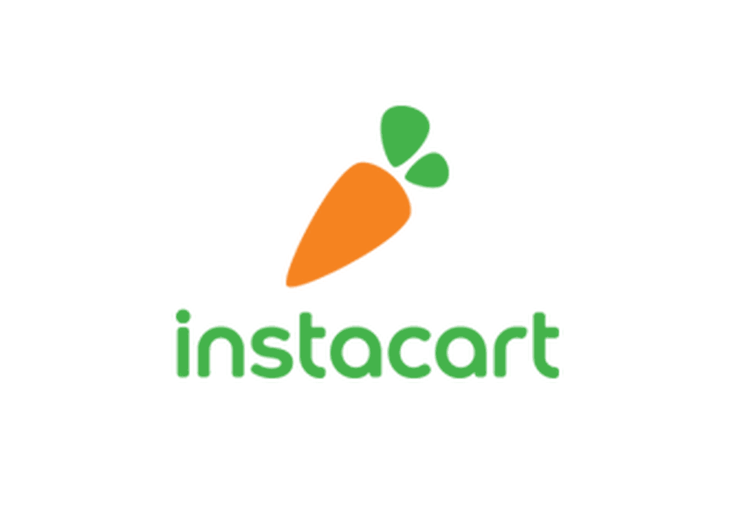
The concept of the Instacart business model has been developed around the purpose of simplifying grocery shopping for people who have a busy life because they can choose all their groceries from wherever they may be.
Instacart is now the top grocery delivery service in the US, valued at over $17 billion.

Slide 3
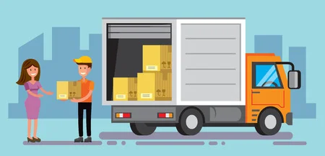
Agenda for this presentation
Problem statements
Analysis on Existing data
Techniques used to solve the problems
Model implementation
Future work
Improvements and results

Slide 4
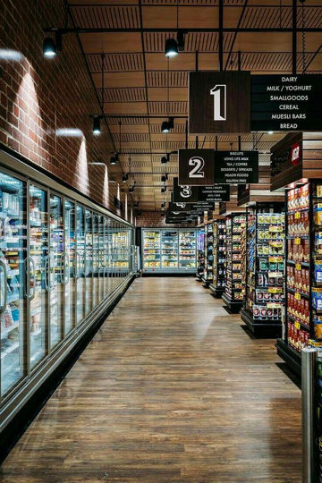
Problem statements
The objective of this project is to address three research questions:
How to tackle the increasing warehousing cost for different stores with the help of instacart data analysis.
Predict whether a product will be reordered or not in the future by the customer.
Predict which department will the next product ordered belong to.

Slide 5

—Ronald Coase, Economist
If you torture the data long enough, it will confess.

Slide 6
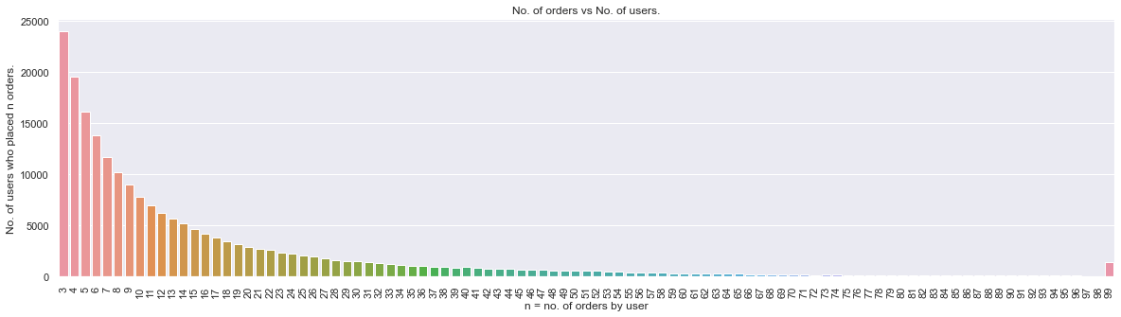
Each user has placed at least 3 orders.
Most users have placed 3-10 orders.

Slide 7
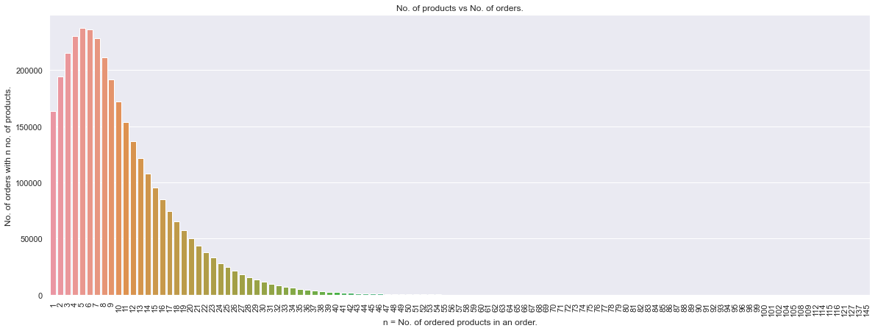
- Customers usually tend to buy less than 20 products in an order.
- Most orders have 5-6 products.

Slide 8
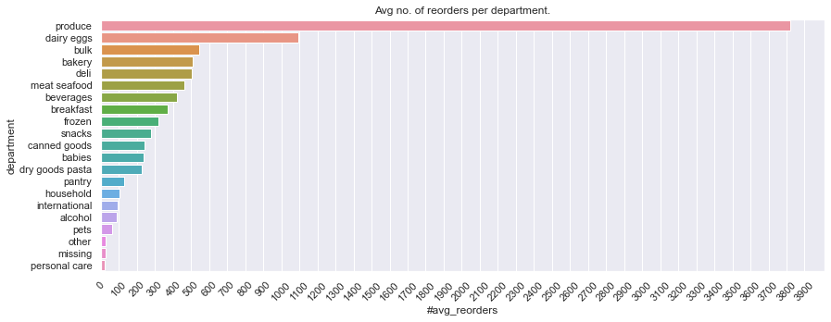
- Produce and dairy eggs departments combined have more avg no. of reorders than all other departments combined. This could be because Produce and dairy eggs departments contain daily needs products.
- Personal care, other and missing departments have very low avg no. of reorders.

Slide 9
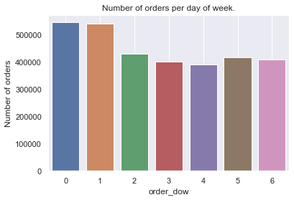
- Saturday and Sunday of week are the most popular of purchasing.

Slide 10
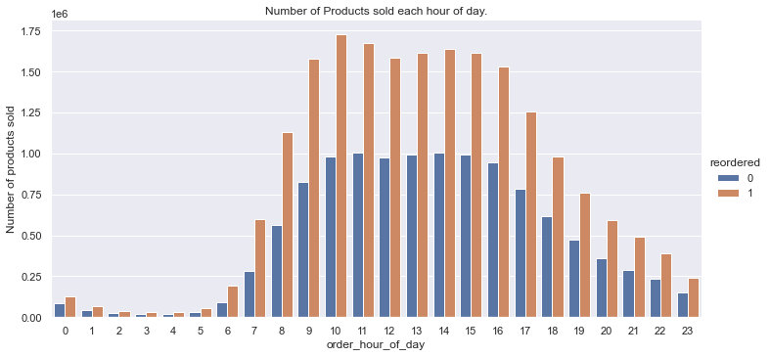
- There is a high count in #orders from 9am till 4pm on daily basis.

Slide 11
Problem 1.
How can we recommend ways to reduce increasing warehouse warehouse cost
Storage space, leased for one year, can average anywhere from $4 to $7 per square foot.
Knowing how to reduce warehouse costs is essential to run any successful company that relies on the import and export of goods.

Slide 12
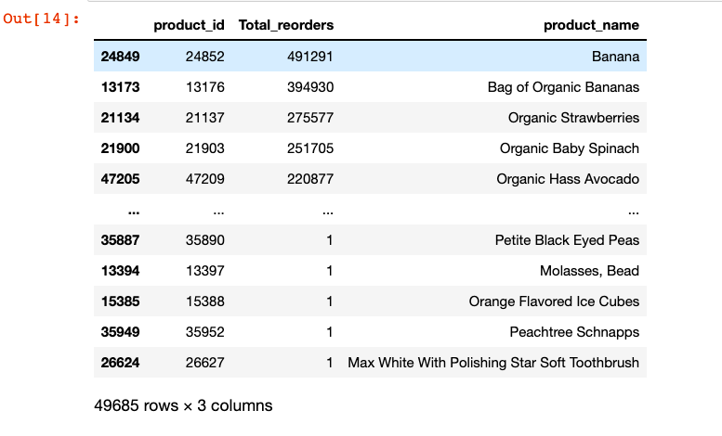
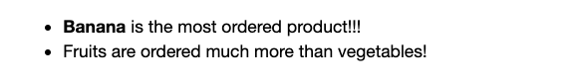
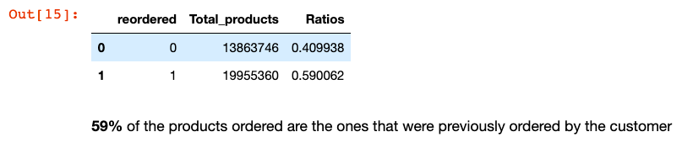
INTRODUCTION
Mercury is the closest planet to the Sun and the smallest one in the Solar System—it’s only a bit larger than our Moon. The planet’s name has nothing to do with the liquid metal, since it was named after the Roman messenger god, Mercury

Slide 13
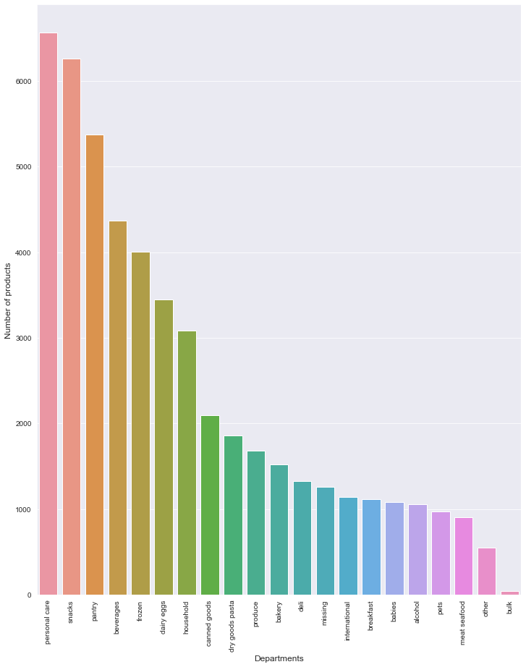
- There is a high count in orders from 9am till 4pm on a day.

Slide 14
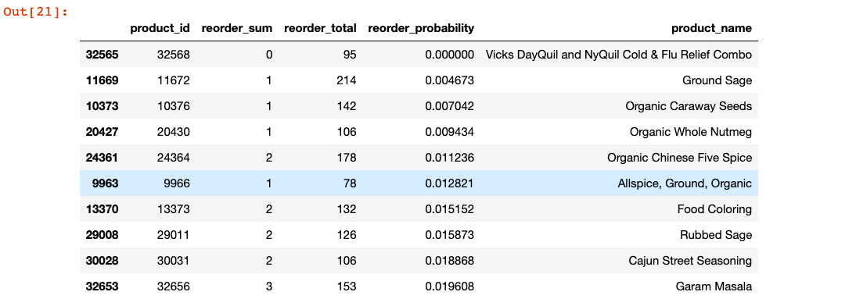
- There is a high count in orders from 9am till 4pm on a day.

Slide 15
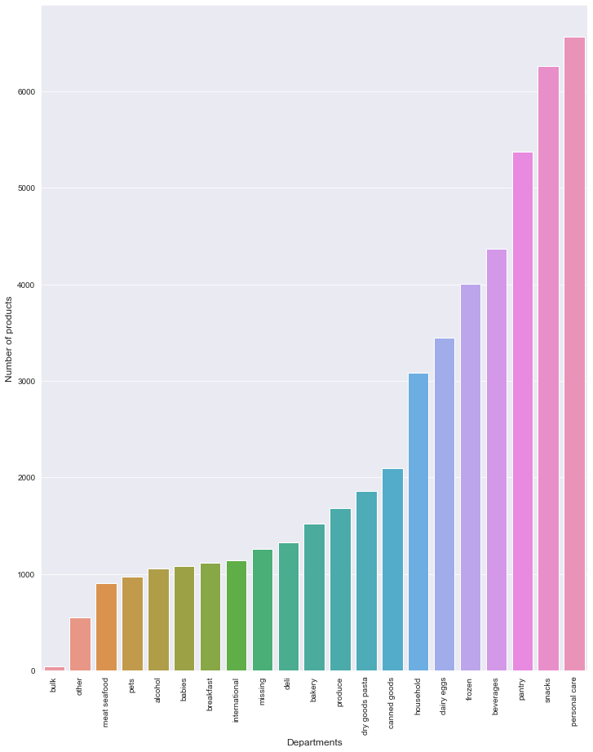
- There is a high count in orders from 9am till 4pm on a day.

Slide 16
Findings
Most important aisles are: Candy chocolate, Fresh Fruits, Yogurt, Vitamins Supplements, Chips, Fresh Vegetables
Least important aisles are: Baby accessories, Frozen Juice, Packaged seafood, Frozen bread doughs, Fresh herbes
Fruits are ordered more than vegetables
Most important departments: Personal Care, Snacks and Pantry
Least important departments: Bulk, Meat seafood, Alcohol and Babies
41% of the products are not reordered, but it's important to note that Sanitary pads, Chocolates and Personal care items, tops reordered list
Number of orders are quite low on thursday and friday

Slide 17
Data cleaning
Feature engineering
Model implementation
RESULT ANALYSIS
01
02
Problem 2 and 3.
Predict whether a product will be reordered or not in the future by the customer.
Predict which department will the next product ordered belong to.
Problem 2.
Predict whether a product will be reordered or not in the future by the customer
03
04

Slide 18
How I cleaned my data
Finding missing values
Fixing structural errors
Merging the tables
Found very few missing values.
Dropped the missing rows
Changed the data types of each feature to required type
Combined the relevant tables for our predictions

Slide 19
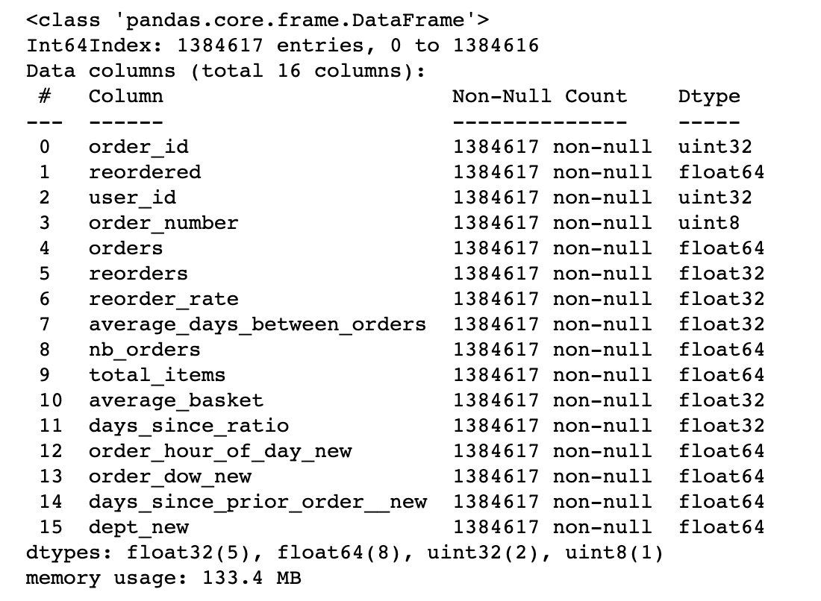

Results after Feature Engineering
Most important aisles are: Candy chocolate, Fresh Fruits, Yogurt, Vitamins Supplements, Chips, Fresh Vegetables
Least important aisles are: Baby accessories, Frozen Juice, Packaged seafood, Frozen bread doughs, Fresh herbes
Fruits are ordered more than vegetables
Most important departments: Personal Care, Snacks and Pantry
Least important departments: Bulk, Meat seafood, Alcohol and Babies
41% of the products are not reordered, but it's important to note that Sanitary pads, Chocolates and Personal care items, tops reordered list
Number of orders are quite low on thursday and friday

Slide 20
Models implemented
Logistic regression
Random forest
Ada boost
Gradient boosting
Logistic regression models the probabilities for classification problems with two possible outcomes.
Random Forest is suitable for situations when we have a large dataset, and interpretability is not a major concern.
It builds a strong classifier by combining multiple poorly performing classifiers so that you will get high accuracy.
It can benefit from regularization methods that penalize various parts of the algorithm and generally improve the performance of the algorithm by reducing overfitting.

Slide 21
Model Results FOR Problem 2
 | Accuracy | Precession | Recall | AUC Score
Logistic regression | 59.7 | 0.86 | 0.62 | 0.56
Random forest | 66.4 | 0.82 | 0.68 | 0.65
Ada boost | 65.6 | 0.8 | 0.68 | 0.64
Gradient boosting |  | 0.82
0.86
Gradient boosting algorithm outperforms the remaining models with better accuracy, recall and AUC score.
67.1
0.69
0.66

Slide 22
Model Results FOR Problem 3
 | Log Loss Score
Random forest
Ada boost | 2.97
Gradient boosting | 2.35
Random forest algorithm gives us least loss log score.
Log-loss is indicative of how close the prediction probability is to the corresponding actual/true value
The more the predicted probability diverges from the actual value, the higher is the log-loss value.
2.34

Slide 23
Recommendations
These analyses can be used to run promotional and marketing campaigns targeting specific customers during peak time.
The insights generated can be used to provide a seamless interface to enhance customer’s user experience by knowing about the customer’s reordered products and automatically adding those to cart.
Personalized communications can be sent to customers’ preferences, reminding them to order again.
To improve customer satisfaction by timely delivery and reduce wait time, the shopper base can be increased by hiring new shoppers who can especially work around the peak time.

Slide 24
Improvements to
the Model

Slide 25
FUTURE Work
For segmentation predictions, market basket algorithms such as apriori can be implemented.
Analysing with delivery related data would also be very effective in predicting the users satisfaction.
We can improve the warehousing storage cost by predicting with more features
New features: - Product Brand information
- Delivery location information
- Store information

Slide 26
Thank you

